Slide 1




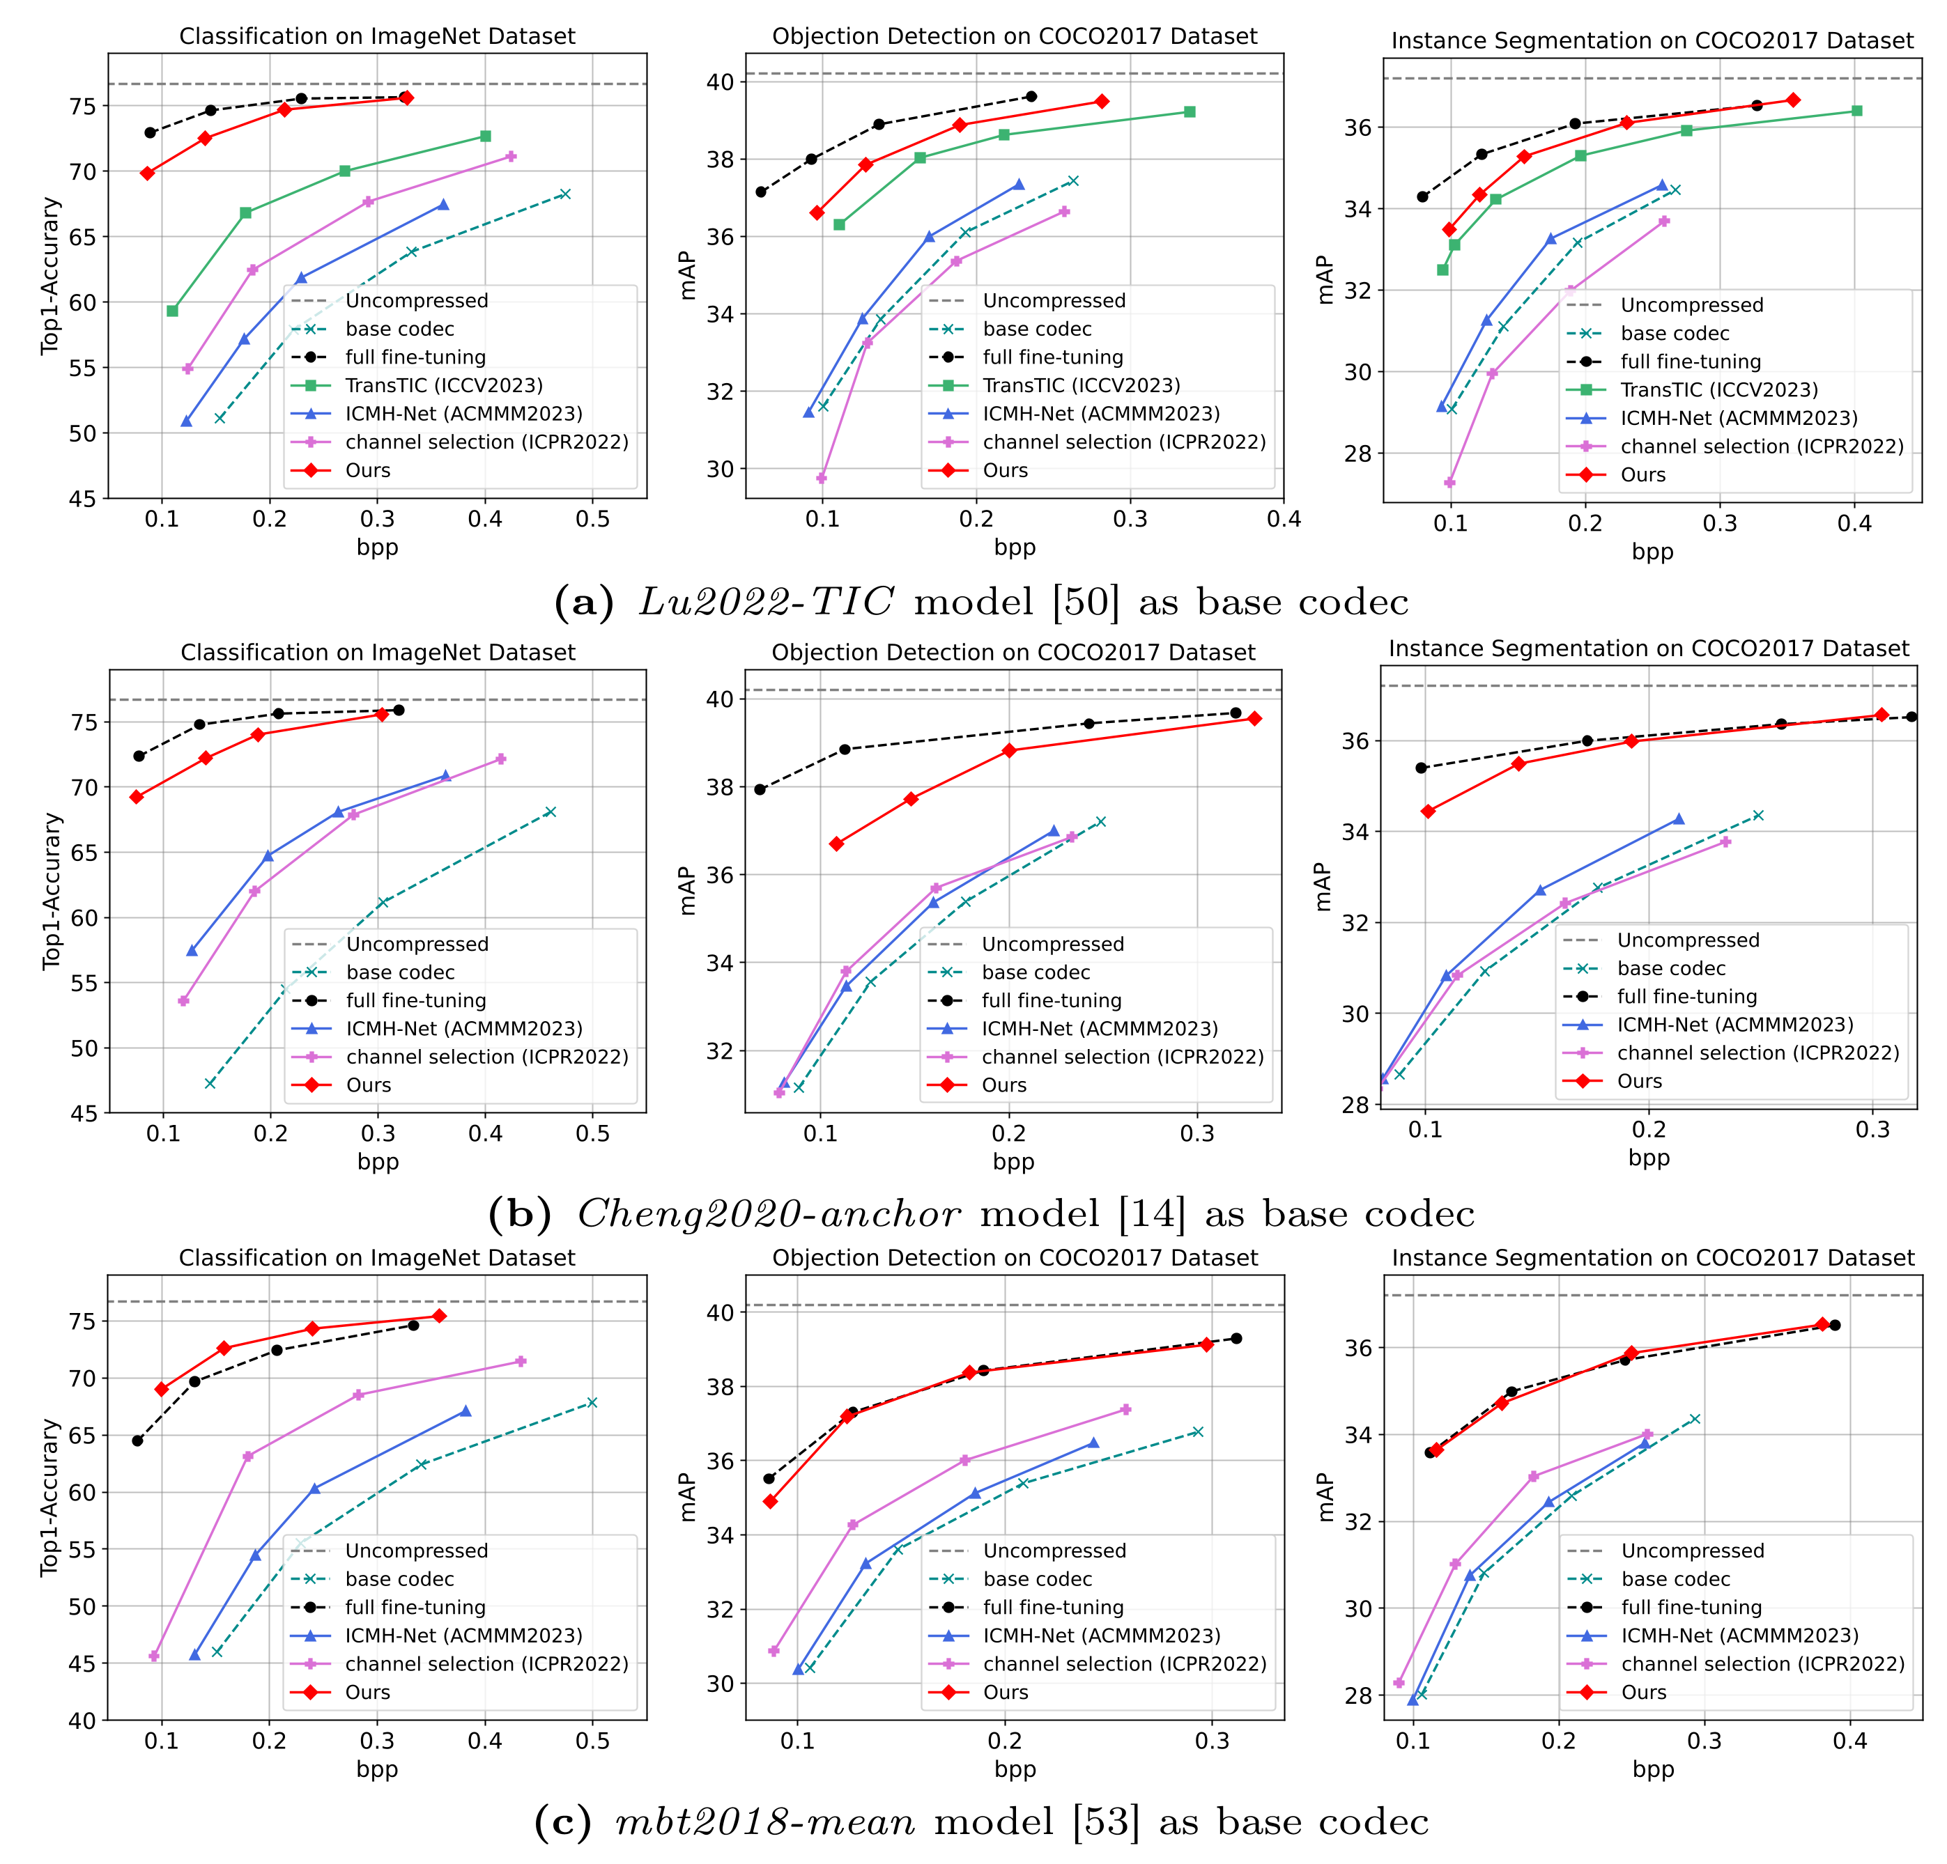
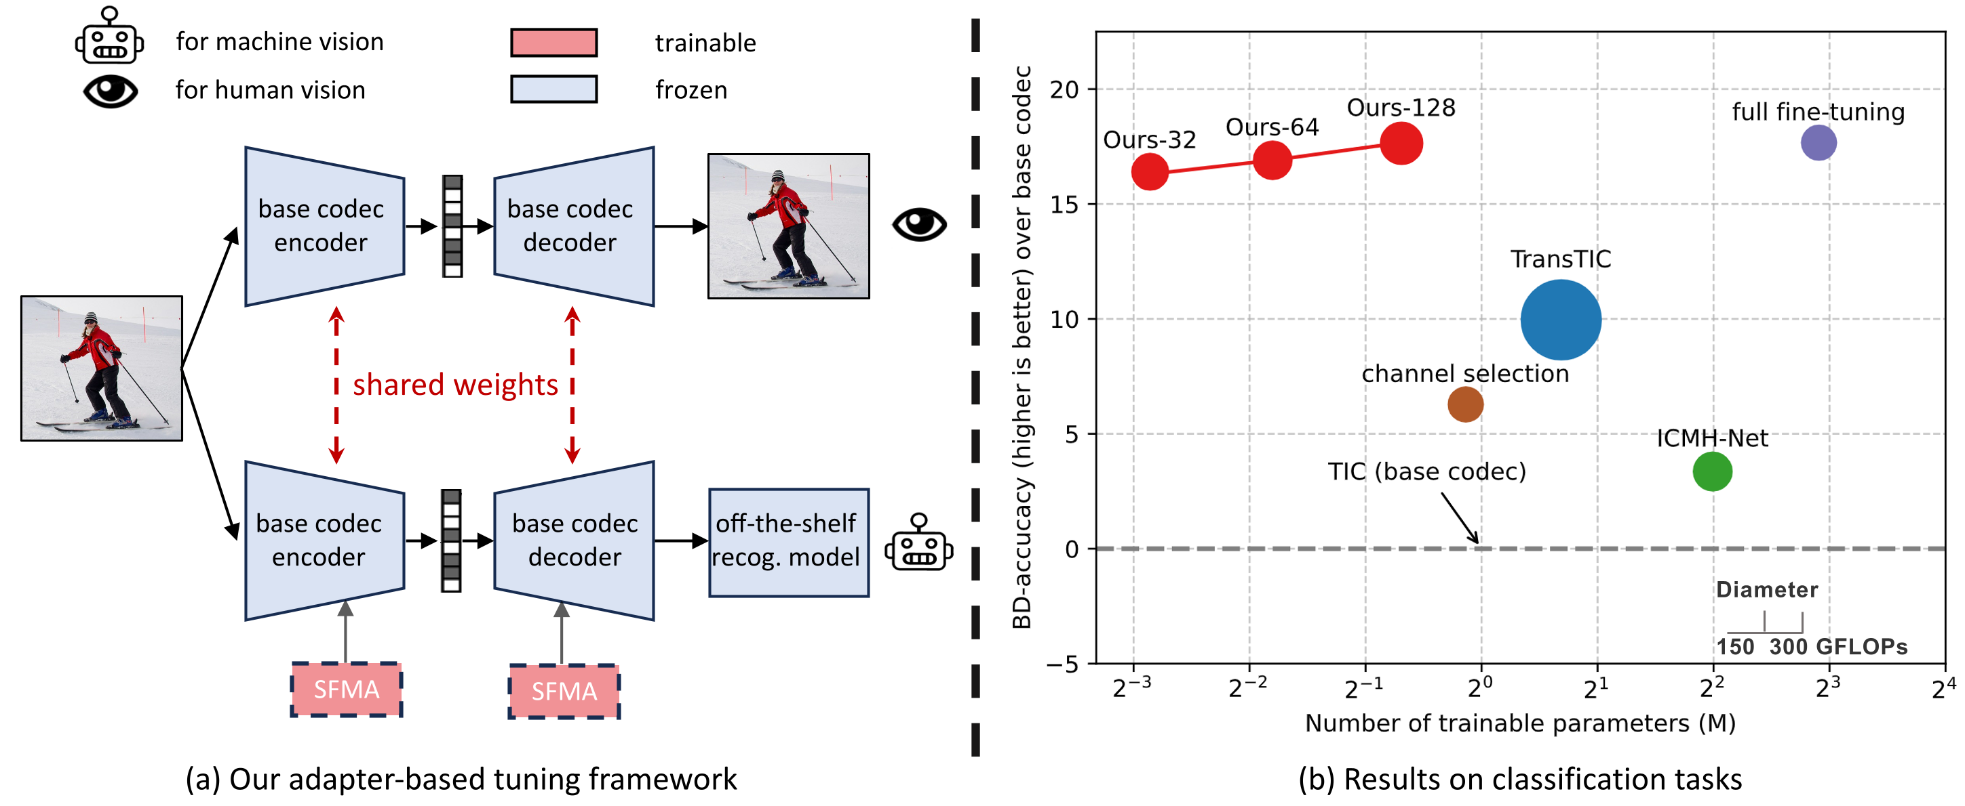
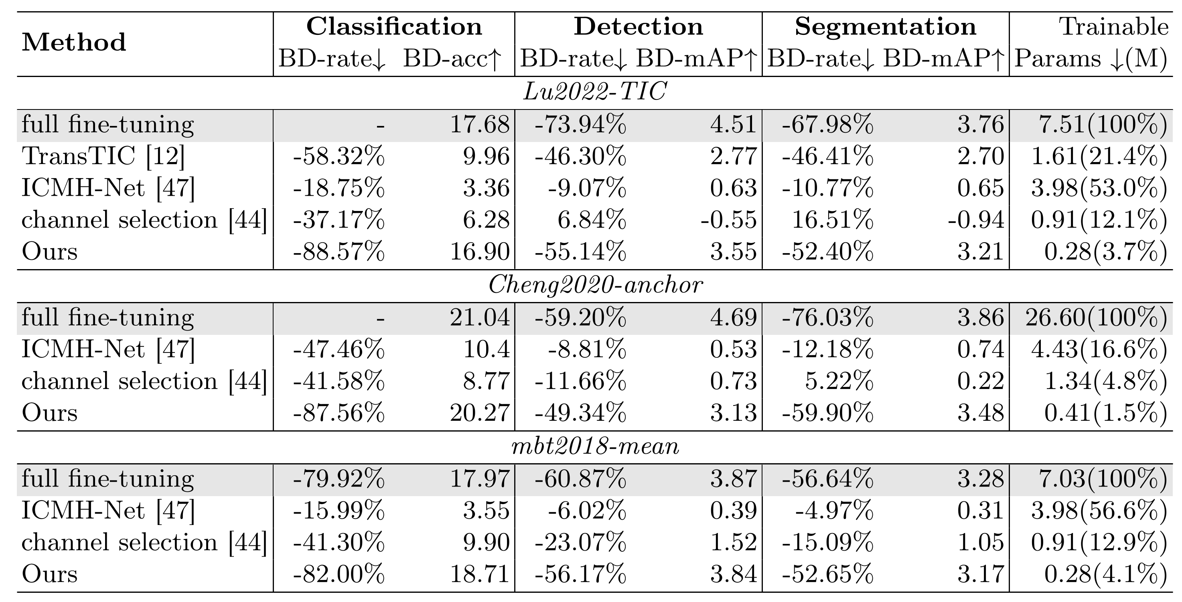

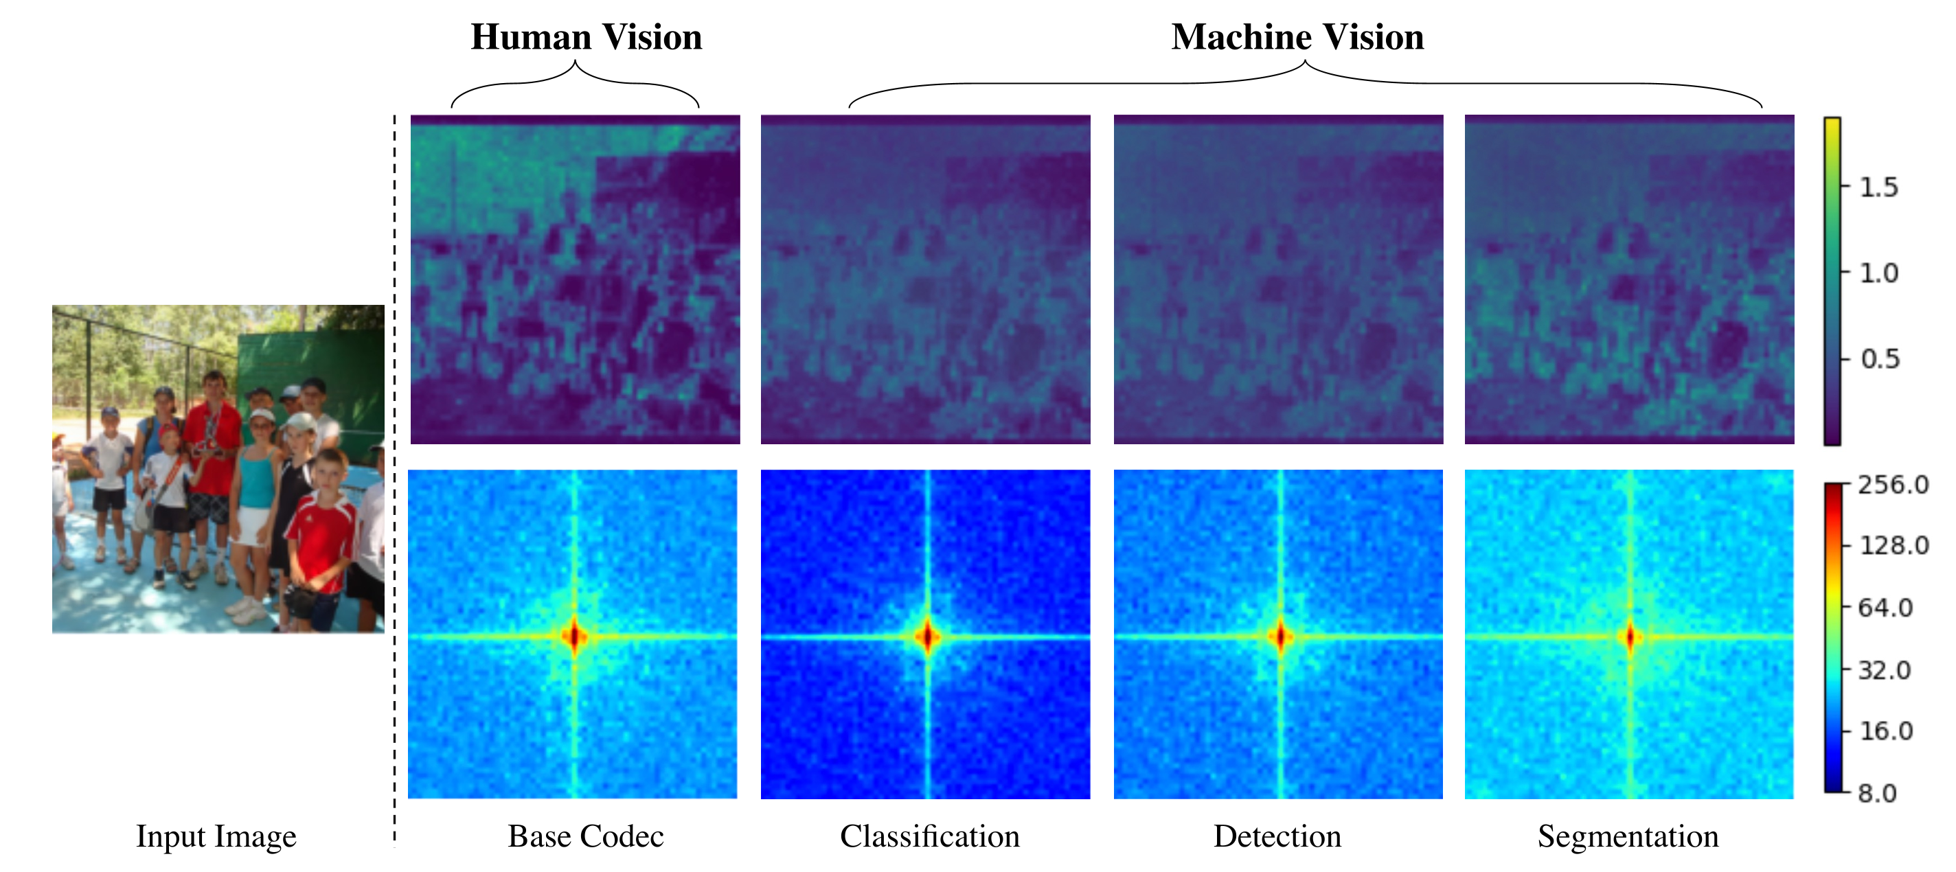

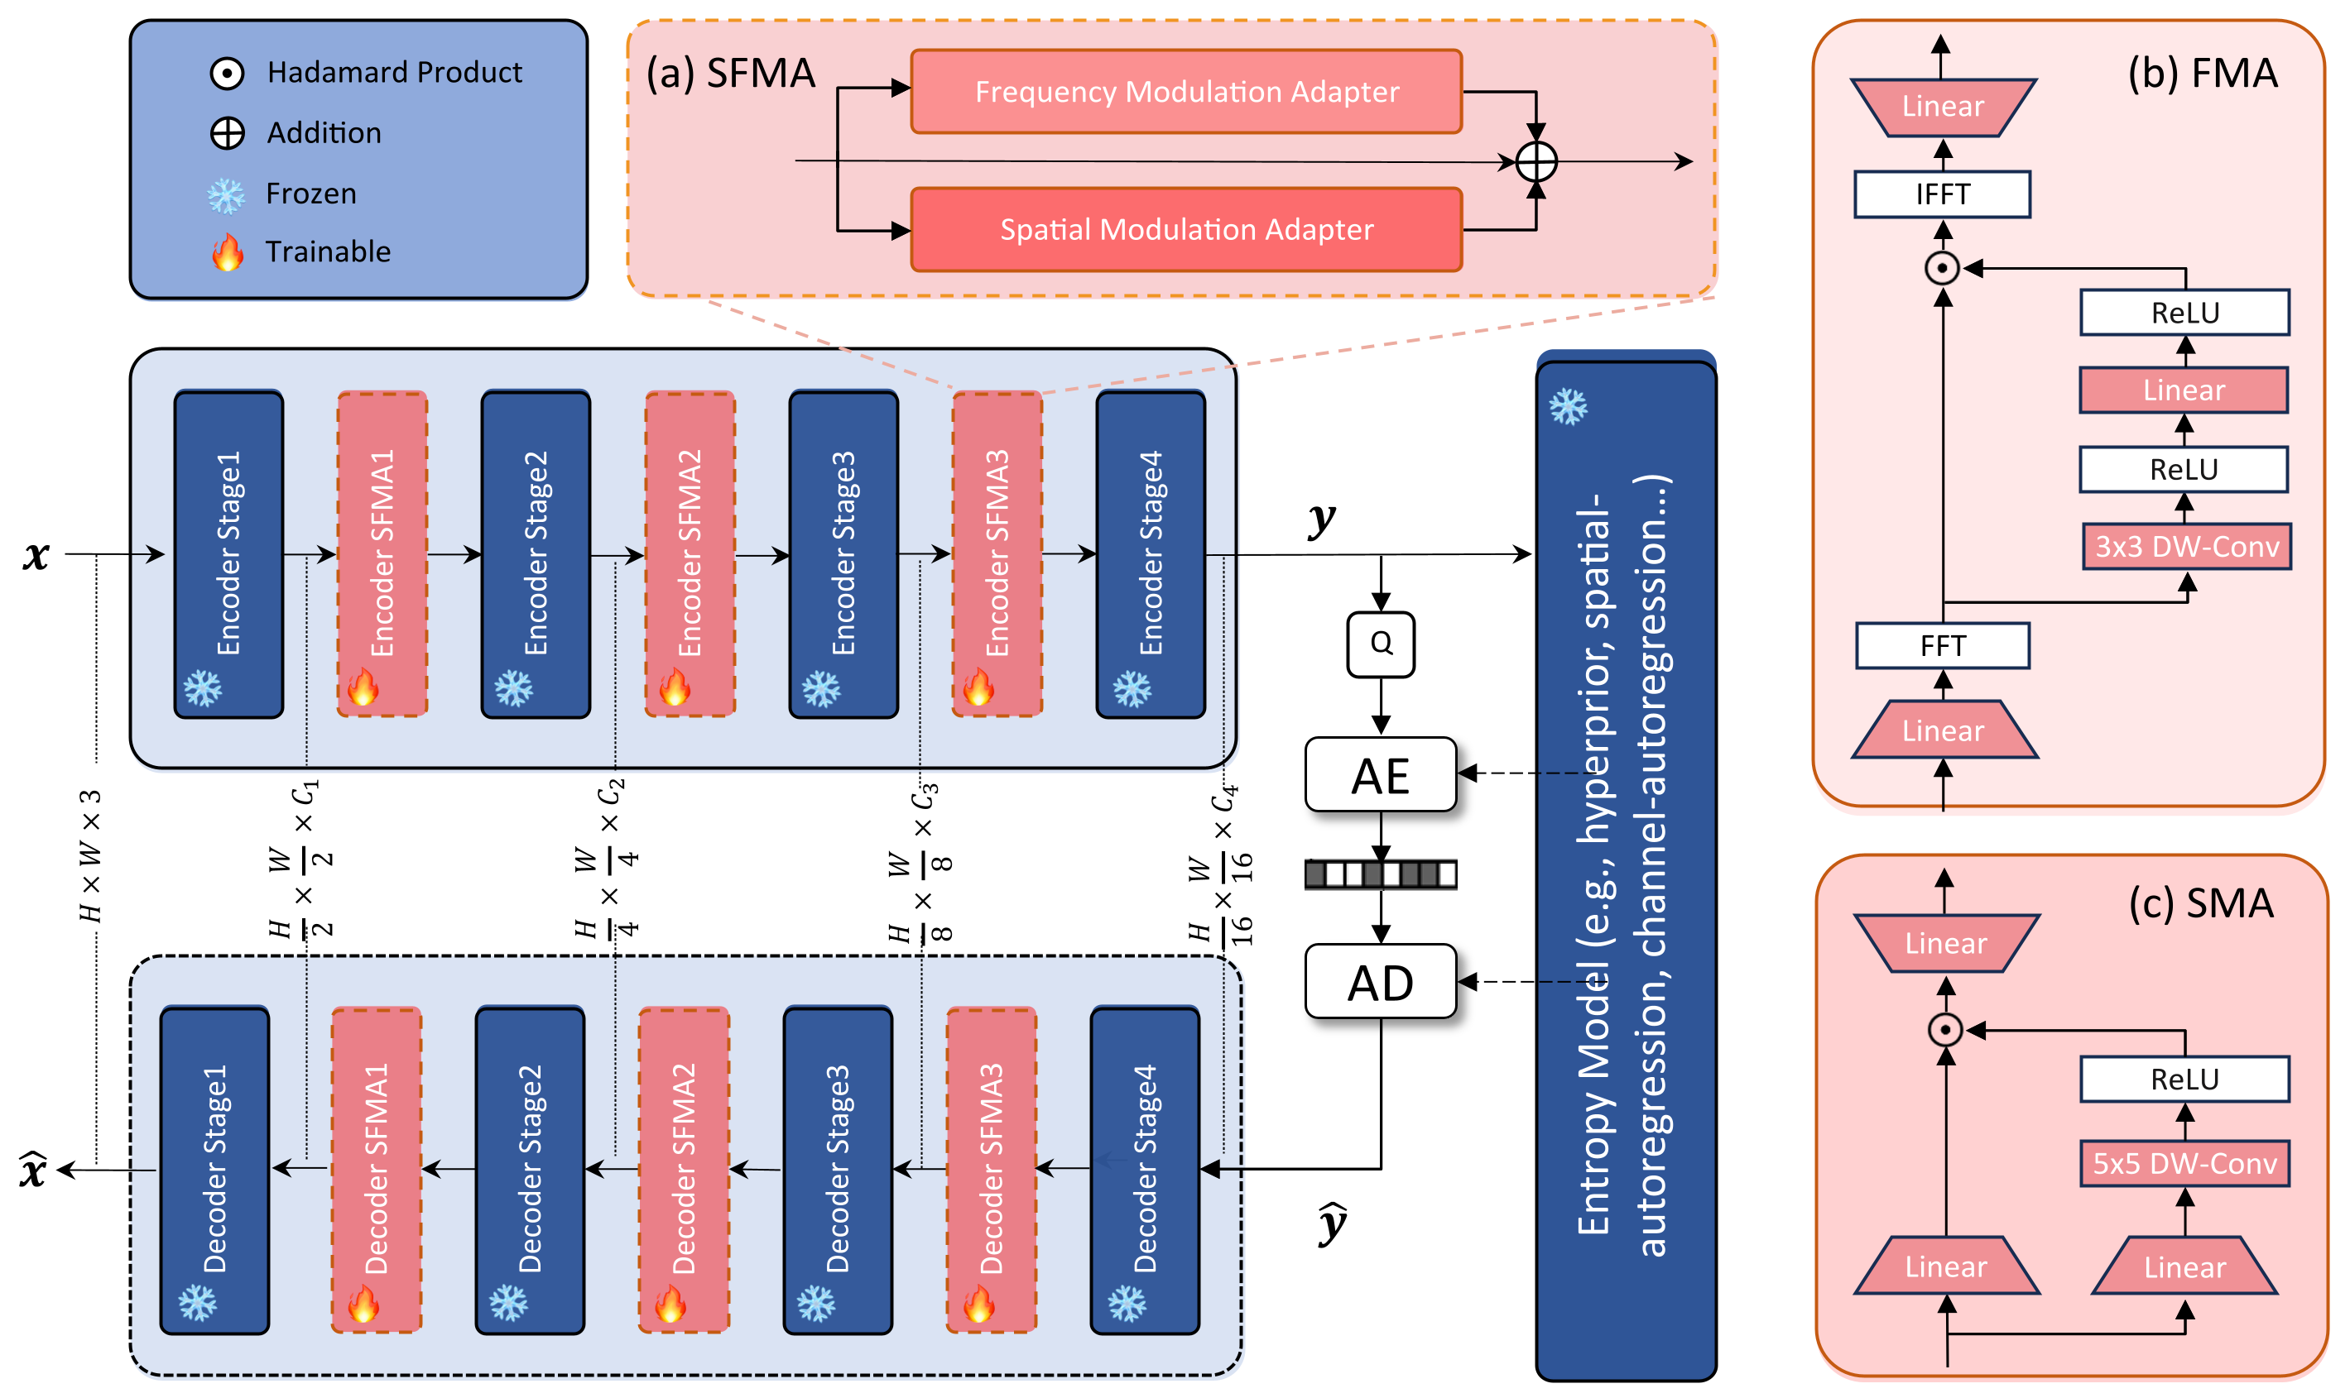

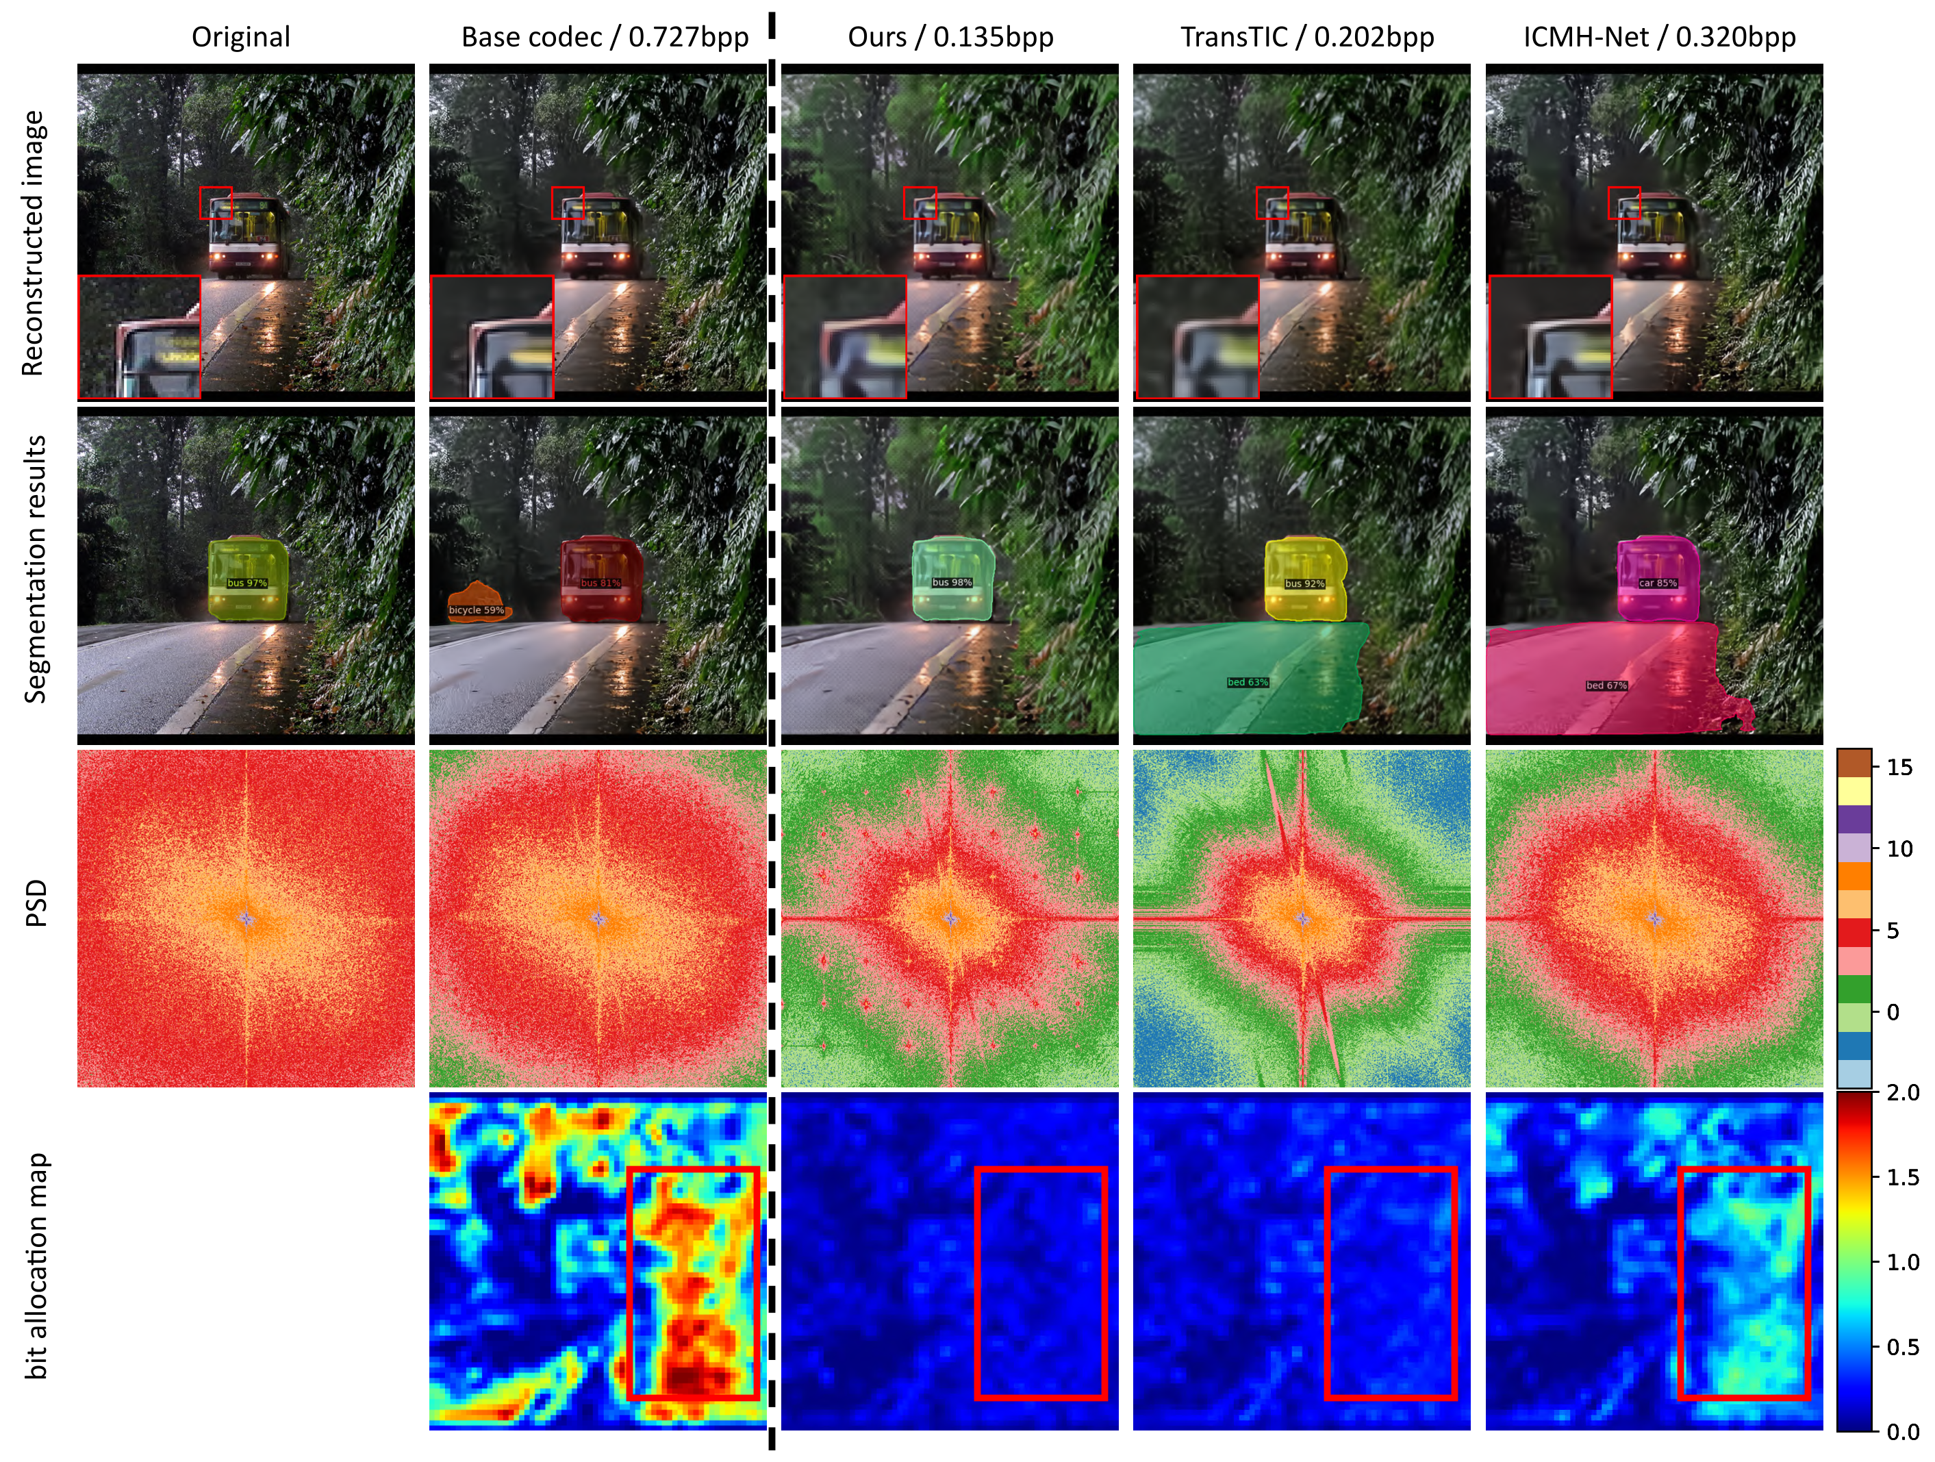



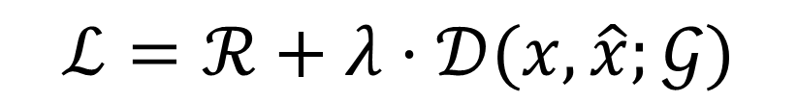
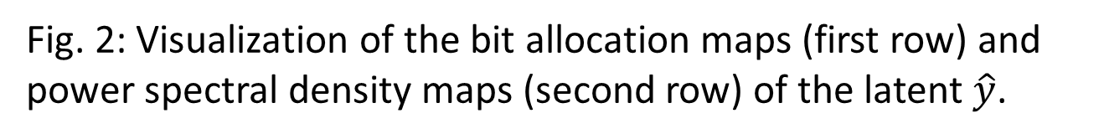
Image Compression for Machine and Human Vision with Spatial-Frequency Adaptation
Han Li¹, Shaohui Li², Shuangrui Ding³, Wenrui Dai¹,
Maida Cao¹, Chenglin Li¹, Junni Zou¹, and Hongkai Xiong¹
¹ SJTU, Shanghai, China ² Tsinghua SIGS, Shenzhen, China ³ CUHK, Hong Kong, China
Introduction
Experimental Results
Image compression for machine and human vision (ICMH) has gained increasing attention in recent years. Existing ICMH methods are limited by high training and storage overheads due to heavy design of task-specific networks.
Rate-accuracy performance on different codecs
Contributions
Fig. 1: Our Adapt-ICMH framework and rate-accuracy performance comparison.
We develop a novel lightweight adapter-based tuning framework Adapt-ICMH, that better balances task performance and bitrates with reduced overheads.
We propose a spatial-frequency modulation adapter (SFMA) to characterize the spatial and frequency domain preferences in different machine vision tasks.
The proposed SFMA is plug-and-play and compatible with almost all existing learned image compression models to achieve ICMH.
Fig. 4: Rate-Accuracy performance comparison under different base codecs and machine vision tasks.
Method
Quantitative comparison with state-of-the-art methods
Motivation
Learned image compression has different spatial and frequency preferences for different tasks
Our Adapt-ICMH outperforms the state-of-the-art methods and demonstrates strong generalization ability under different base codecs and machine vision tasks.
The lightweight Adapt-ICMH requires fewer trainable parameters to achieve ICMH with a shared base codec.
Fig. 2: Visualization of the bit allocation maps (first row) and
power spectral density maps (second row) of the latent $\hat{y}$.
Spatial-Frequency Modulation Adapter (SFMA)
Visualization
Fig. 5: Qualitative comparison of our Adapt-ICMH with other ICMH methods.
Fig. 3: Overview of our proposed Adapt-ICMH framework.
Conclusion
The proposed SFMA consists of two parallel sub-modules, i.e., a spatial modulation adapter (SMA) and a frequency modulation adapter (FMA).
FMA eliminates frequency redundancies and amplifies the important frequency components for machine vision tasks. SMA guides the codec to focus more on the semantic region and reduce the spatial redundancies in the background.
During the adaptation to the machine vision task, the base codec is frozen and only these adapters are trainable.
In this paper, we develop a novel adapter-based tuning framework Adapt-ICMH to transfer the pre-trained image codec from human perception to machine perception.
The SFMA effectively eliminates latent redundancies in spatial and frequency domains.
SFMA is plug-and-play and compatible with existing learned image compression models.
Adapt-ICMH reduces the number of trainable parameters and computational complexity.
$$ℒ=ℛ+λ⋅𝒟(x,\hat{x};𝒢)$$
Efficient tuning for ICMH
Adapt-ICMH has achieved preeminent results across diverse machine vision tasks and base codecs, providing novel insights for ICMH.
Acknowledgement
More Information
This work was supported in part by the National Natural Science Foundation of China under Grant 62125109, Grant 61931023, Grant 61932022, Grant 62371288, Grant 62320106003, Grant 62301299, Grant T2122024, Grant 62120106007, China Postdoctoral Innovation Talents Support Program (BX20230184).
Feel free to follow and contact MIN Lab!
xionghongkai@sjtu.edu.cn
daiwenrui@sjtu.edu.cn
Paper Link
Notes:
In the field of Image Compression for Machine and Human Vision (ICMH), efficiently fine-tuning pre-trained human vision-oriented image codecs for machine vision tasks remains a challenge. There is an urgent need for a lightweight tuning framework that better balances task performance and bitrates while minimizing overhead.
In this paper, we develop a novel adapter-based tuning framework for ICMH, named Adapt-ICMH. Specifically, we fine-tune the pre-trained image codec optimized for human vision on multiple machine vision tasks, which is achieved by the proposed spatial-frequency modulation adapter (SFMA). Our SFMA can efficiently reduce the latent redundancies in both spatial and frequency domains, and effectively adapt the decoded image for downstream machine vision tasks. Our method is plug-and-play and compatible with all existing learned image compression models. Experiments show that our method consistently outperforms other ICMH methods in various machine vision tasks, even with a reduced number of trainable parameters and computational complexity.
Adapt-ICMH has achieved preeminent results across multiple machine vision tasks, providing new insights for ICMH.

